Slide 1
Logic Gate Assignment
By Anhadjot Singh

Slide 2
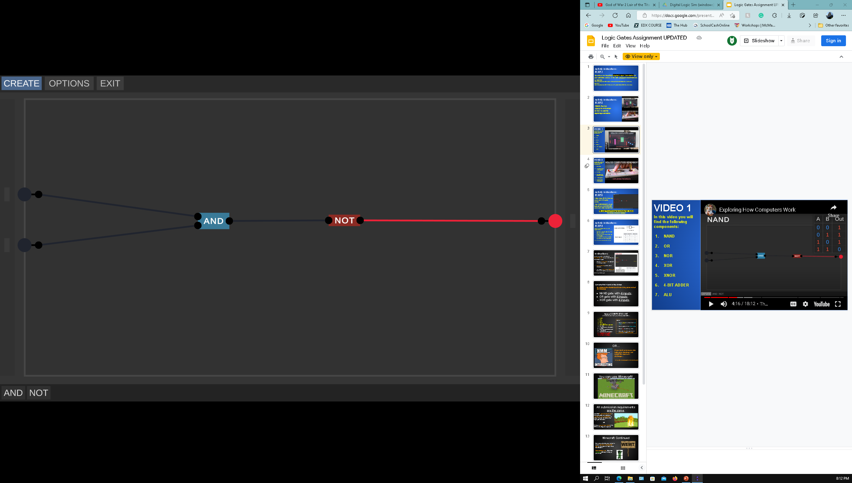
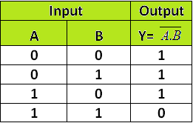
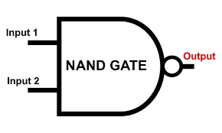
NAND Gate
The Nand gate will only provide an output if one or no input is turned on. If both inputs are turned on the output will turn off. Simply, the power will be inverted if both gates are turned on. If one of A or B is turned on then there will be an output.

Slide 3
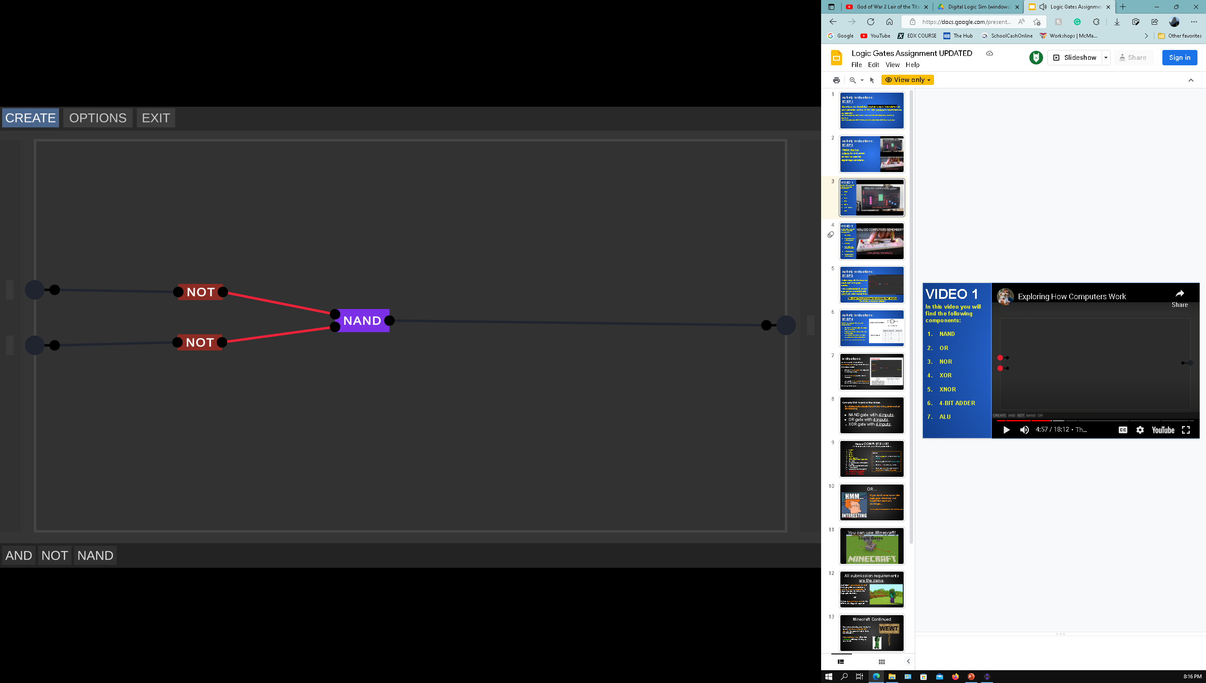
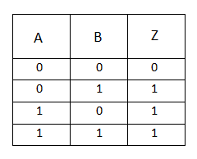
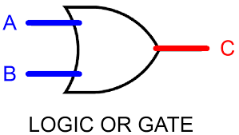
OR GATE
This is an OR Gate. This gate will receive a powered output if any of the inputs are turned on. However, if both inputs are turned off then the output will be 0.

Slide 4

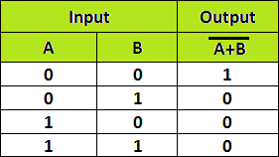
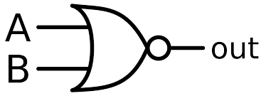
Nor gate
This is a NOR Gate. This gate functions as the opposite of the OR Gate. In this case, if any of the inputs are turned on then the output will be 0. However, if none of the inputs are turned on then the output will turn on.

Slide 5
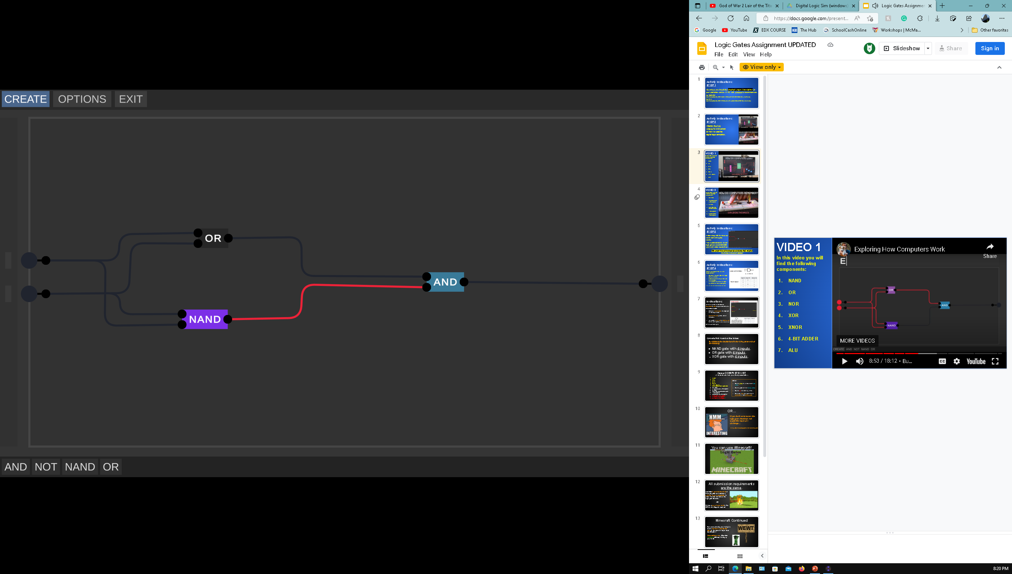
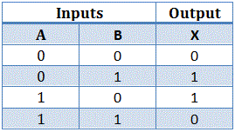
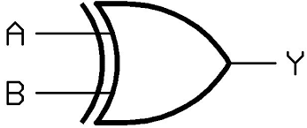
XOR Gate
This is a XOR Gate. If none of the inputs are turned on, then the gate will have no output. If one of the inputs are turned on, then there will be an output. However, if both inputs are on then the output will remain 0.

Slide 6
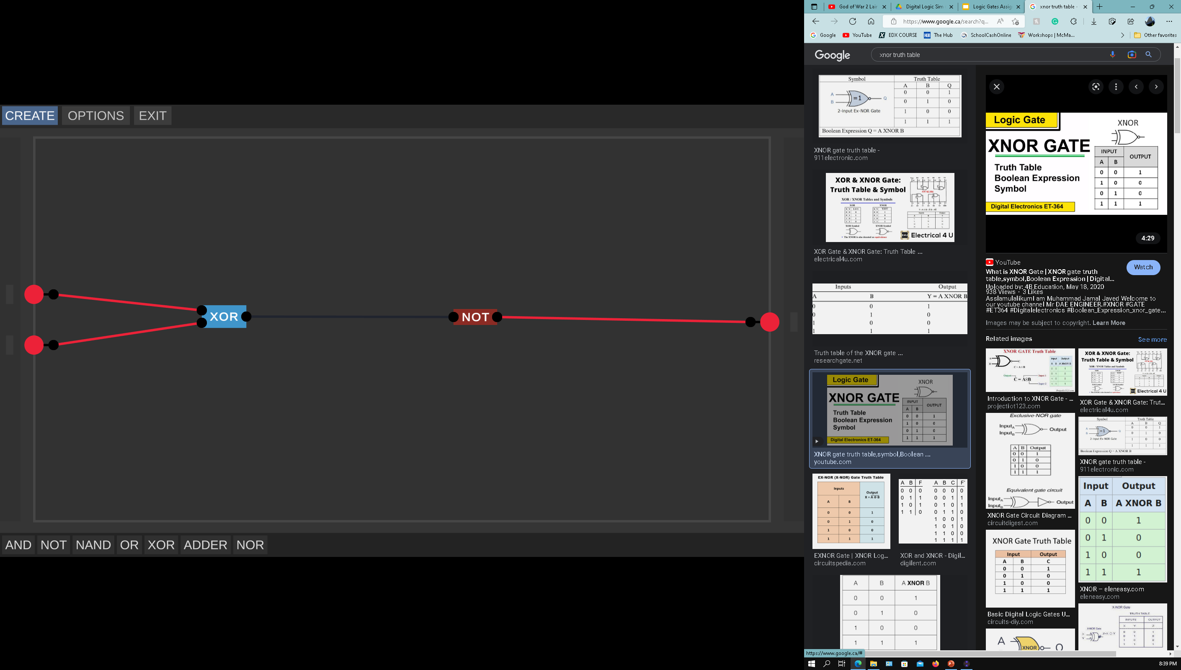
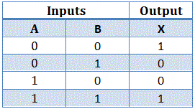
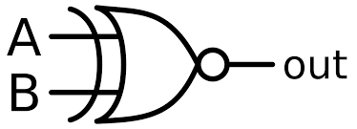
XNOR Gate
This is a XNOR Gate. This gate functions as an opposite to the XOR Gate. This is because the outputs are inverted; if both inputs are turned off then the output will be powered. If both inputs are on then the output will be powered. However, if only one input is on then the output will remain 0.

Slide 7
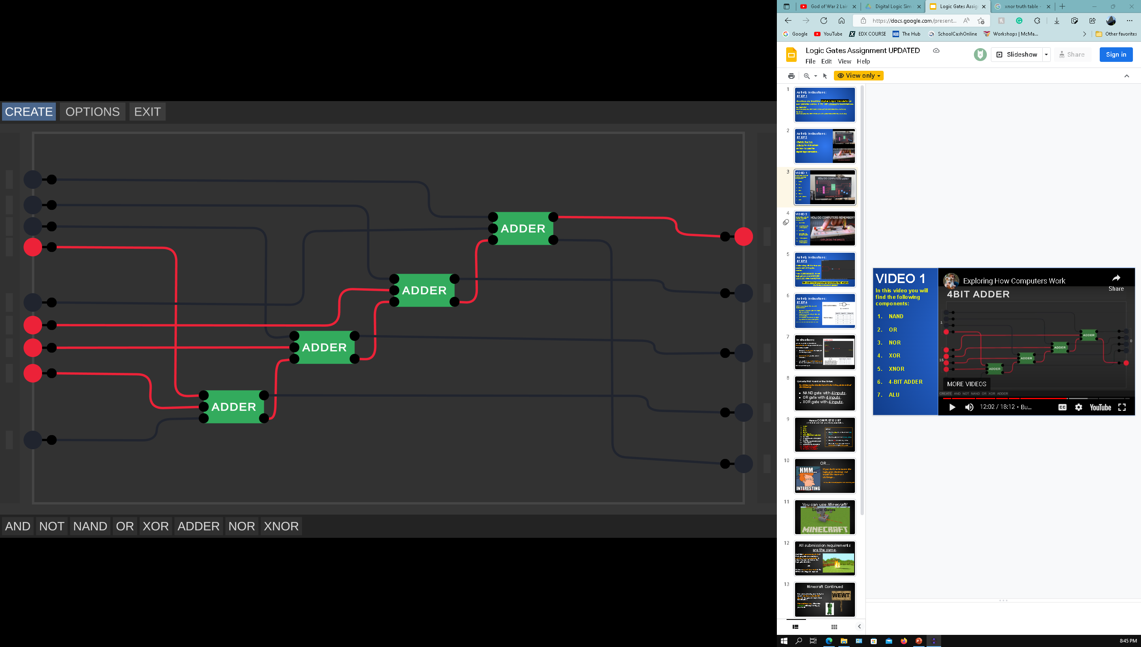
4 bit adder
This is a 4 BIT ADDER. This is essentially a calculator that can calculate up to 15. There are 3 sets of inputs; the three sets are the numbers that are added together to give an output/answer. However, the output on the very bottom is called a carry bit. The carry bit indicates that there aren’t enough bits to store more than 15. If the carry bit is on that means the values have “overflowed” and is more than 15. The 4 outputs (other than the carry bit) indicates the value/answer to the calculation as long as the answer is below/is 15.

Slide 8
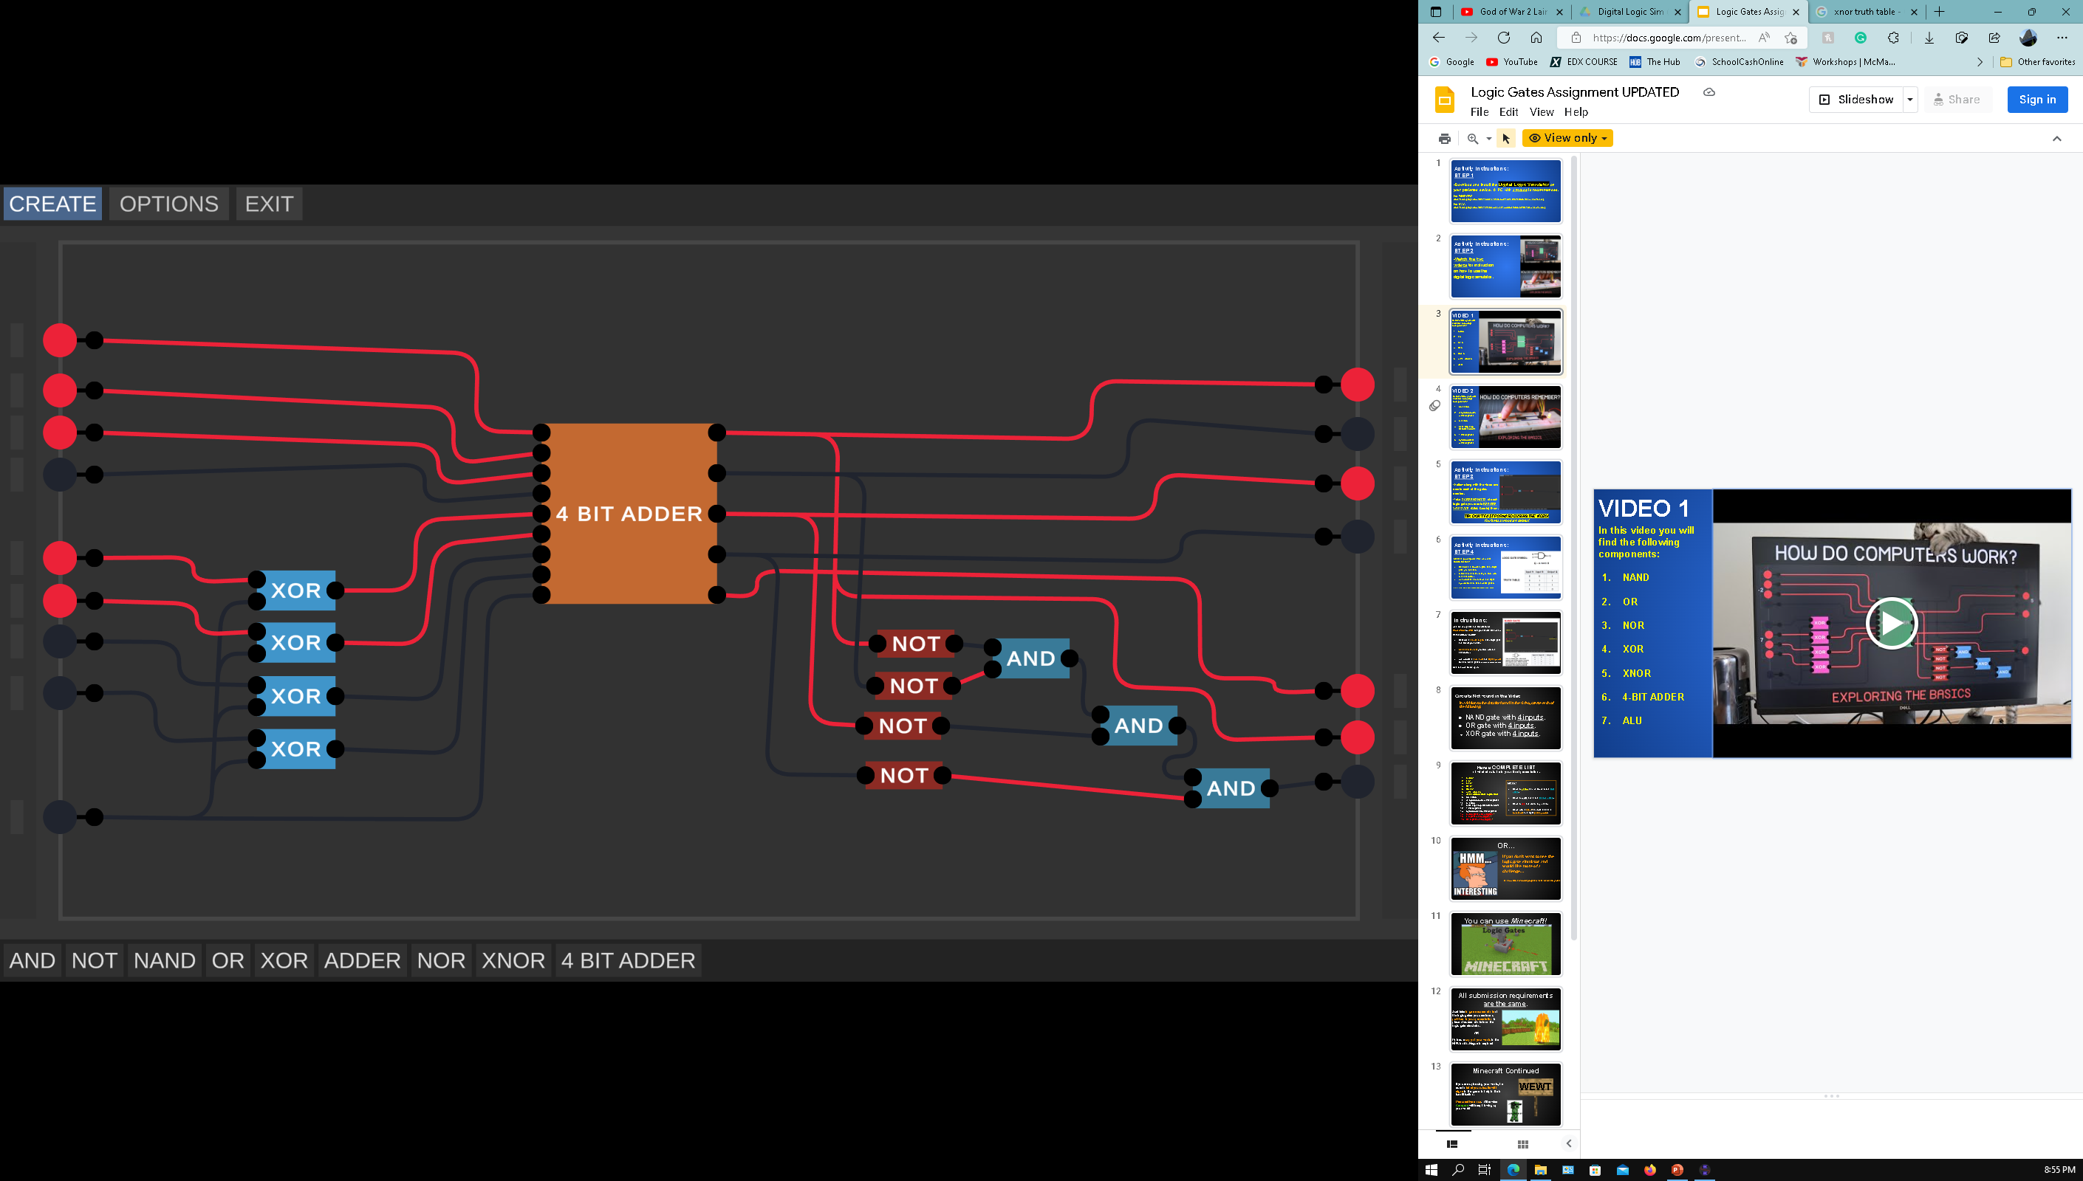
ALU
This is an Arithmetic Logic Unity or ALU. On the left side, there are 2 sets of inputs that represent numbers/bits. The very bottom input is a subtract signal which turns the process into subtraction. The first 4 outputs on the right side indicate the answer/number of bits calculated. The last three outputs give information about the result of the numbers calculated. The third last input is a carry bit, the second last output indicates if the answer is negative by turning on, and the last output indicates that the sum is zero.

Slide 9
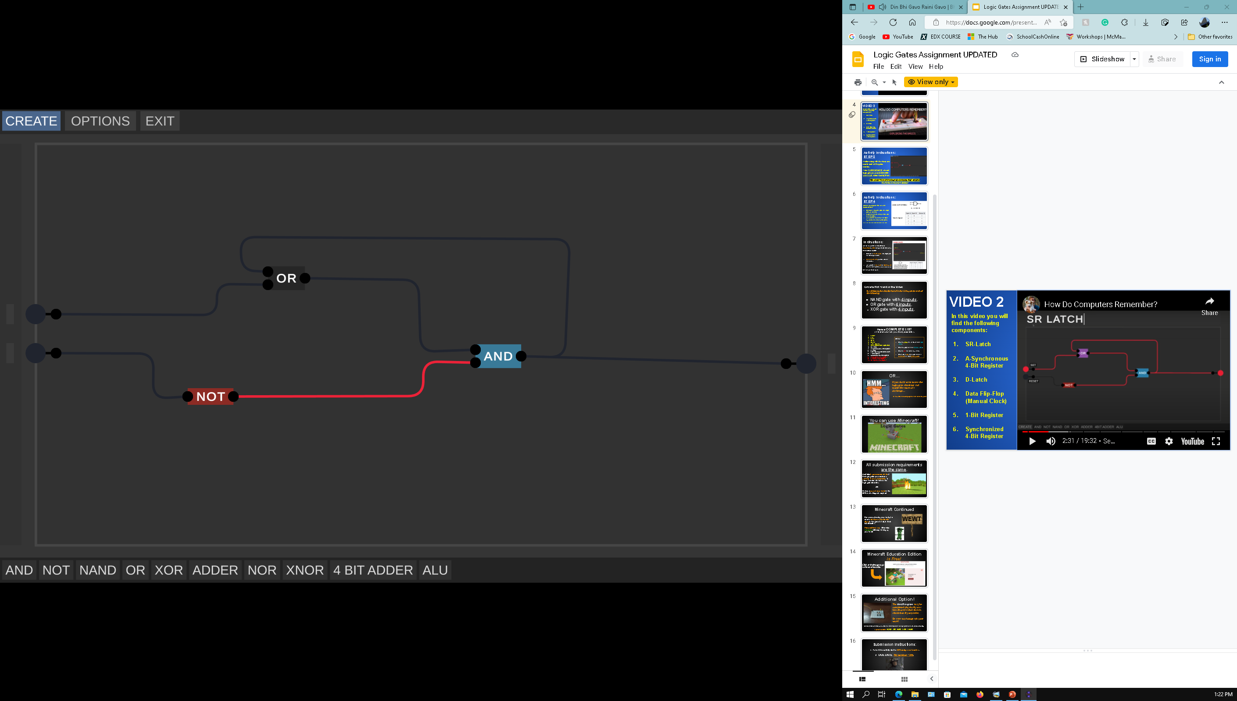
SR Latch
This is a Set-Reset Latch. The first input on the right side is called the Set Input. When the Set input is turned on the output will turn on. However, when the Set input is turned off, the circuit will continue to remain on because the circuit is “remembering” the inputs and is in a loop regardless of the Set input being turned off or on. The second input is called the Reset signal/input, the duty of this input is to reset the circuit by inverting the power from the NOT gate and causing only one input to provide power to the AND gate, ultimately resetting the circuit.

Slide 10
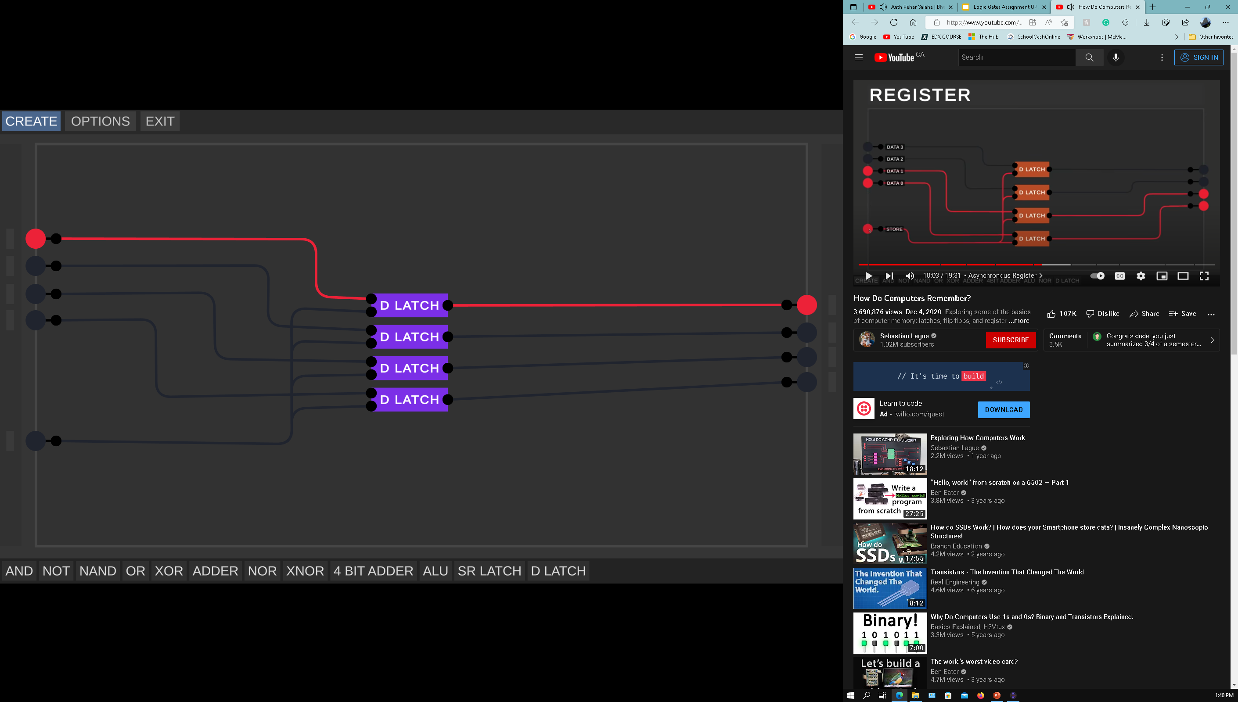
Asynchronous Register
This is a 4 Bit Asynchronous Register

Slide 11
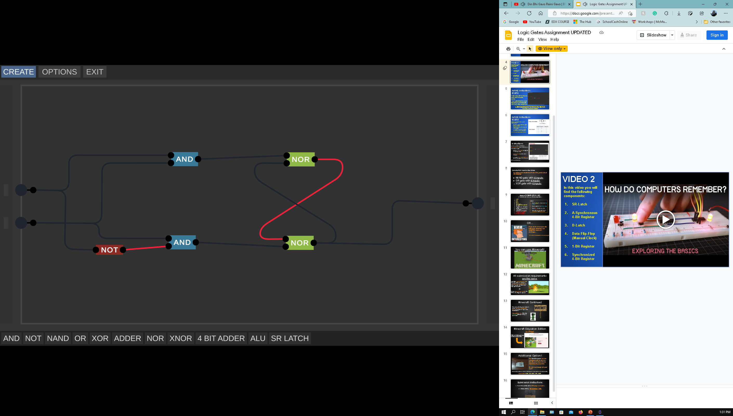
D LATCH

Slide 12
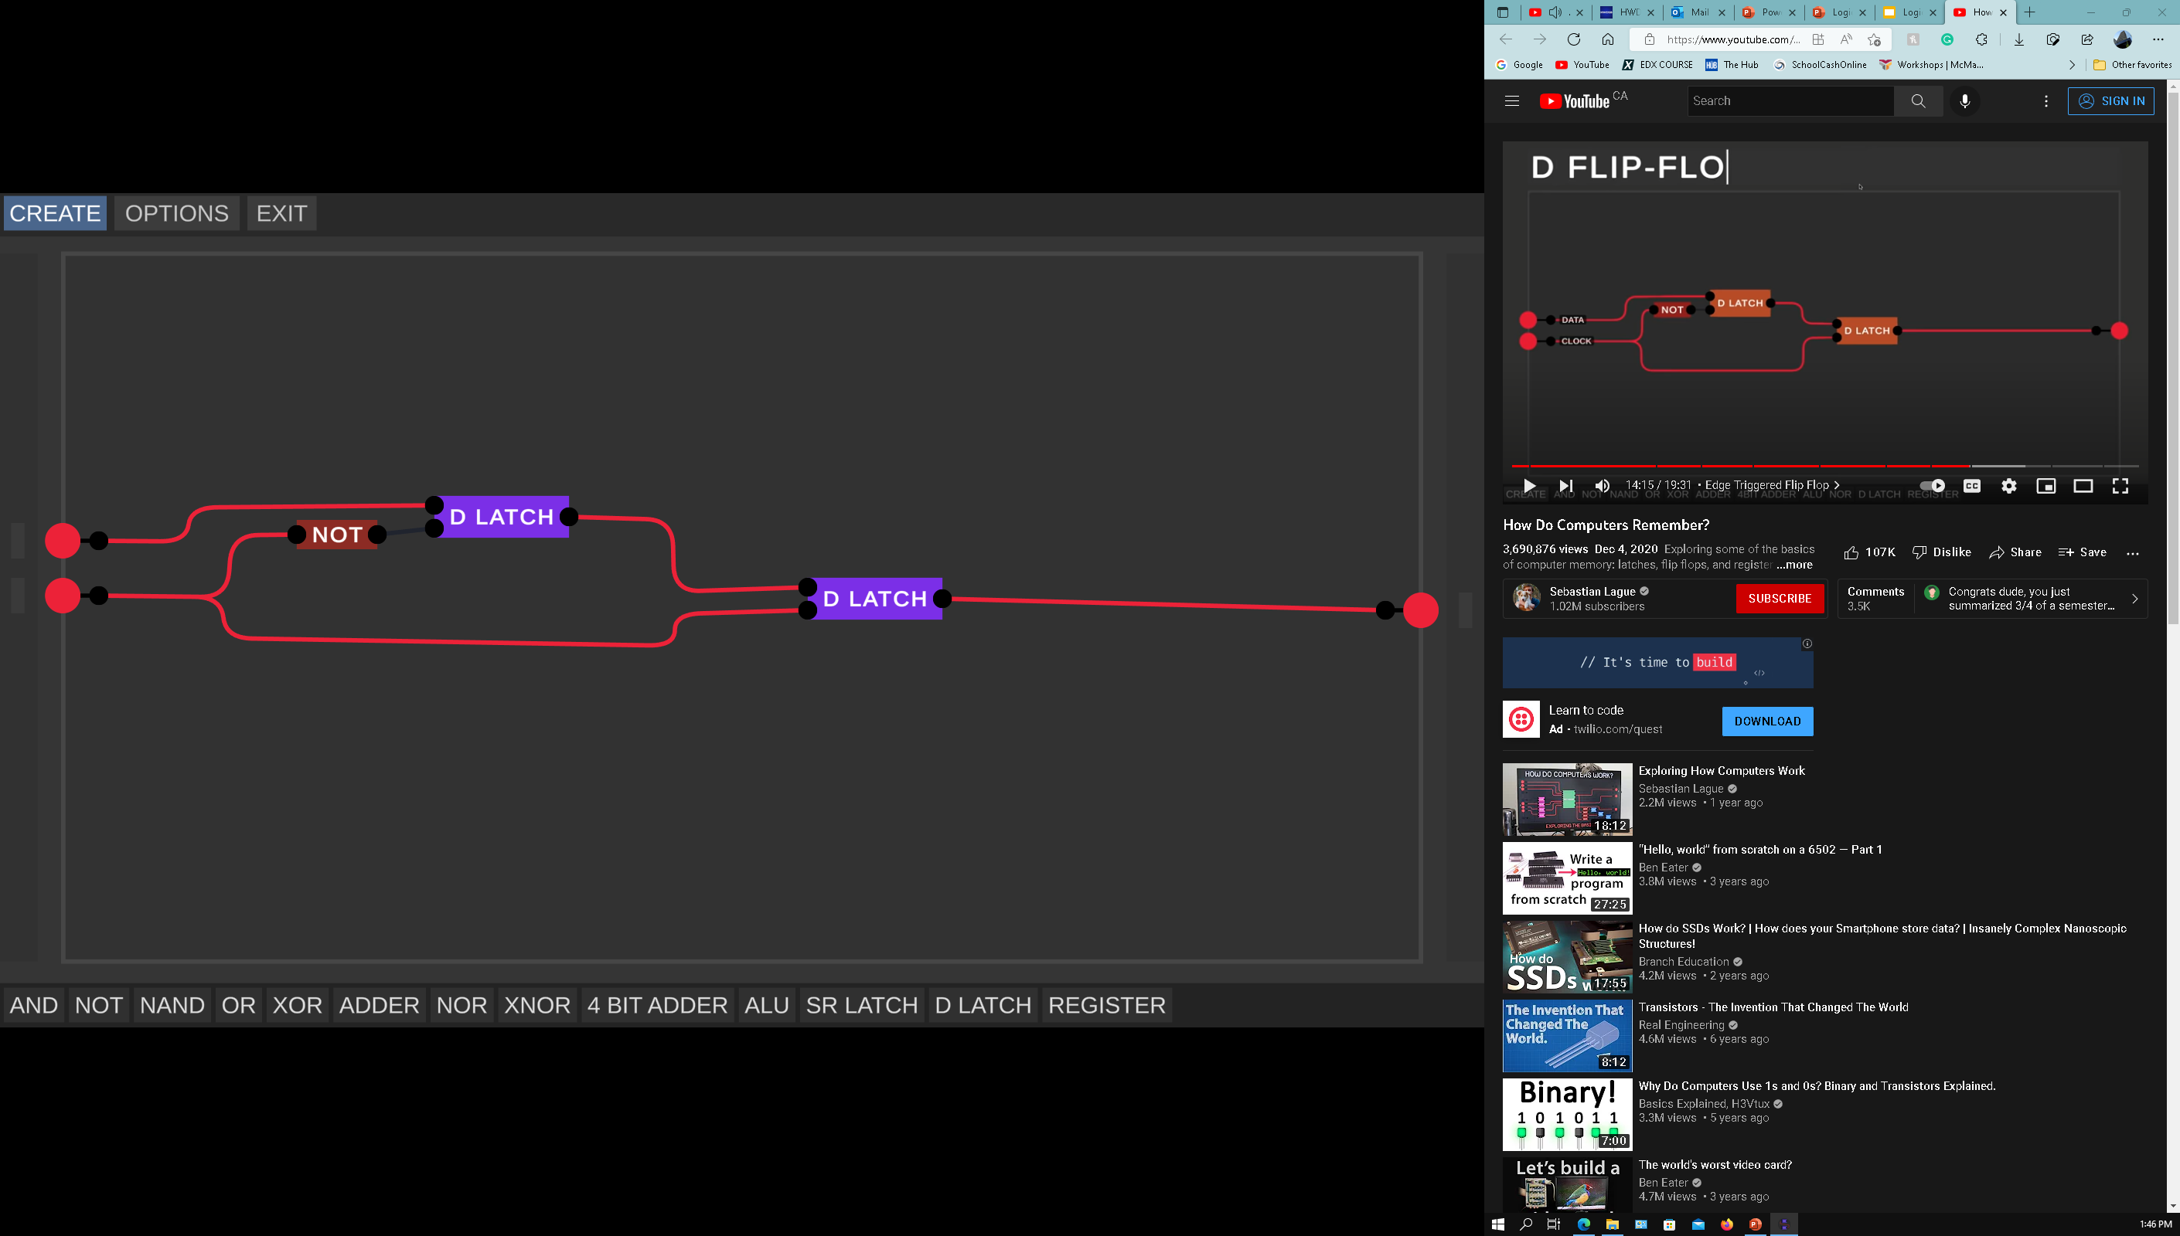
D Flip FLop

Slide 13
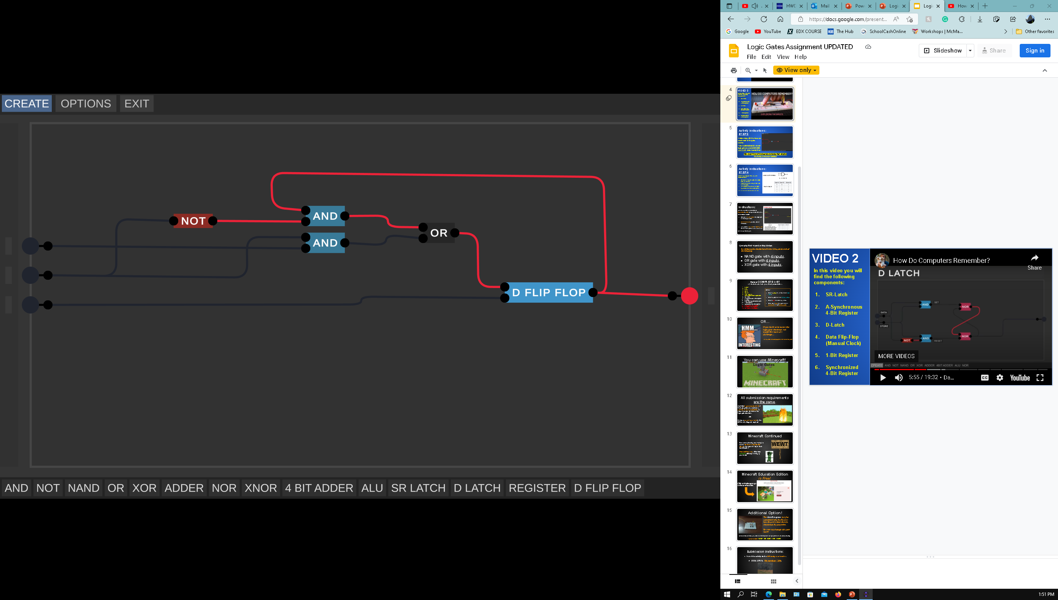
1 bit register

Slide 14
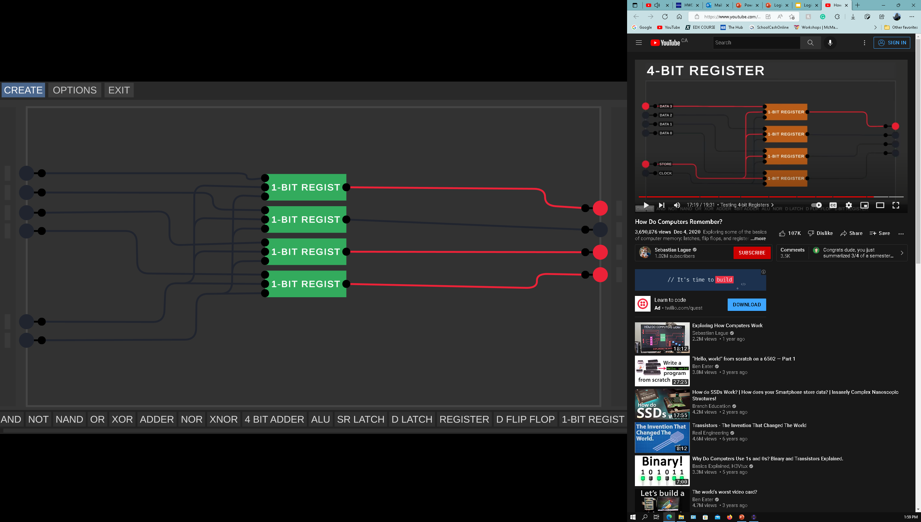
Synchronized 4 bit register

Slide 15
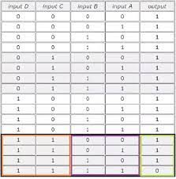
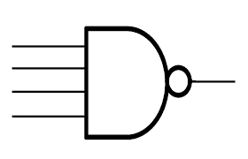
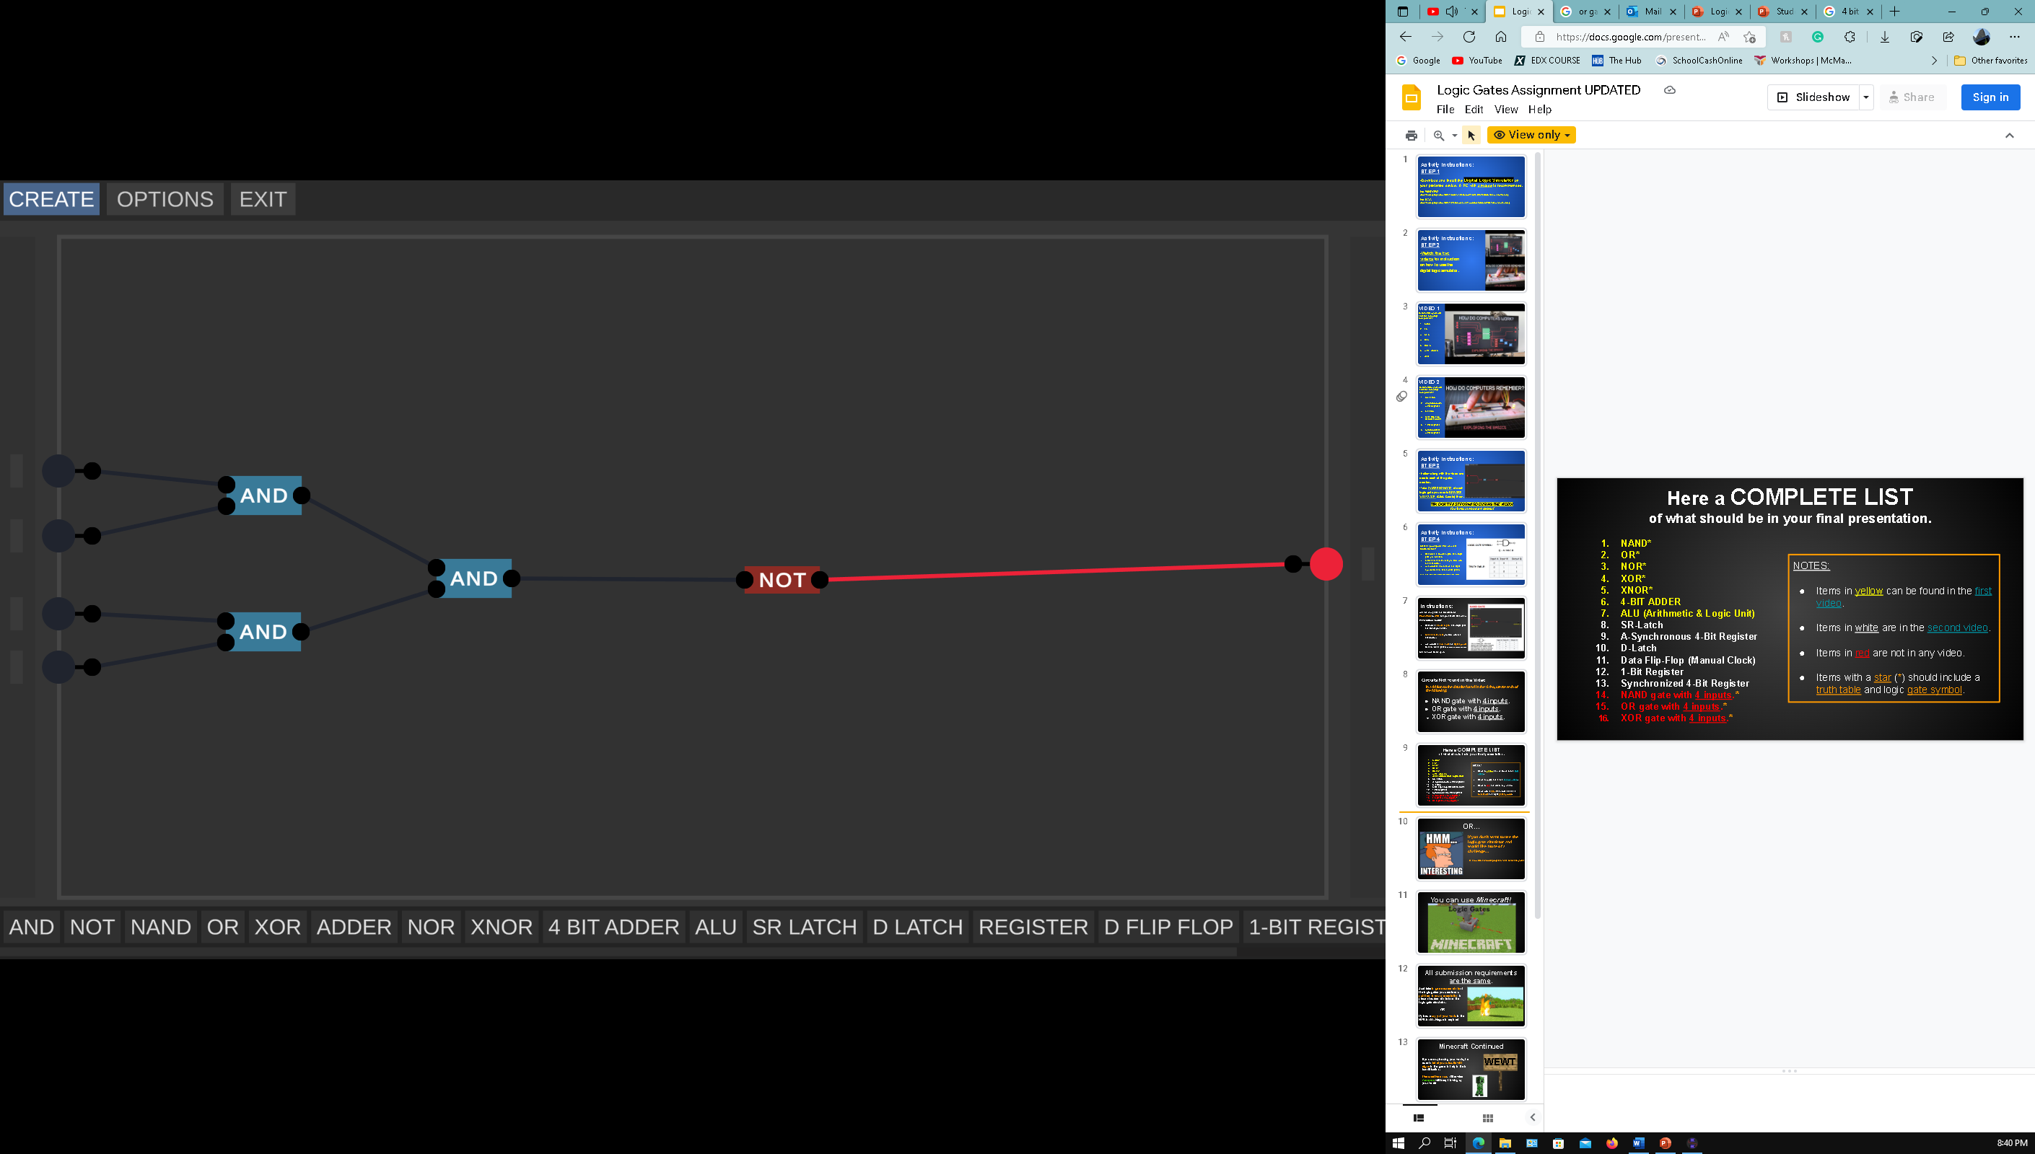
Nand Gate with 4 inputs

Slide 16
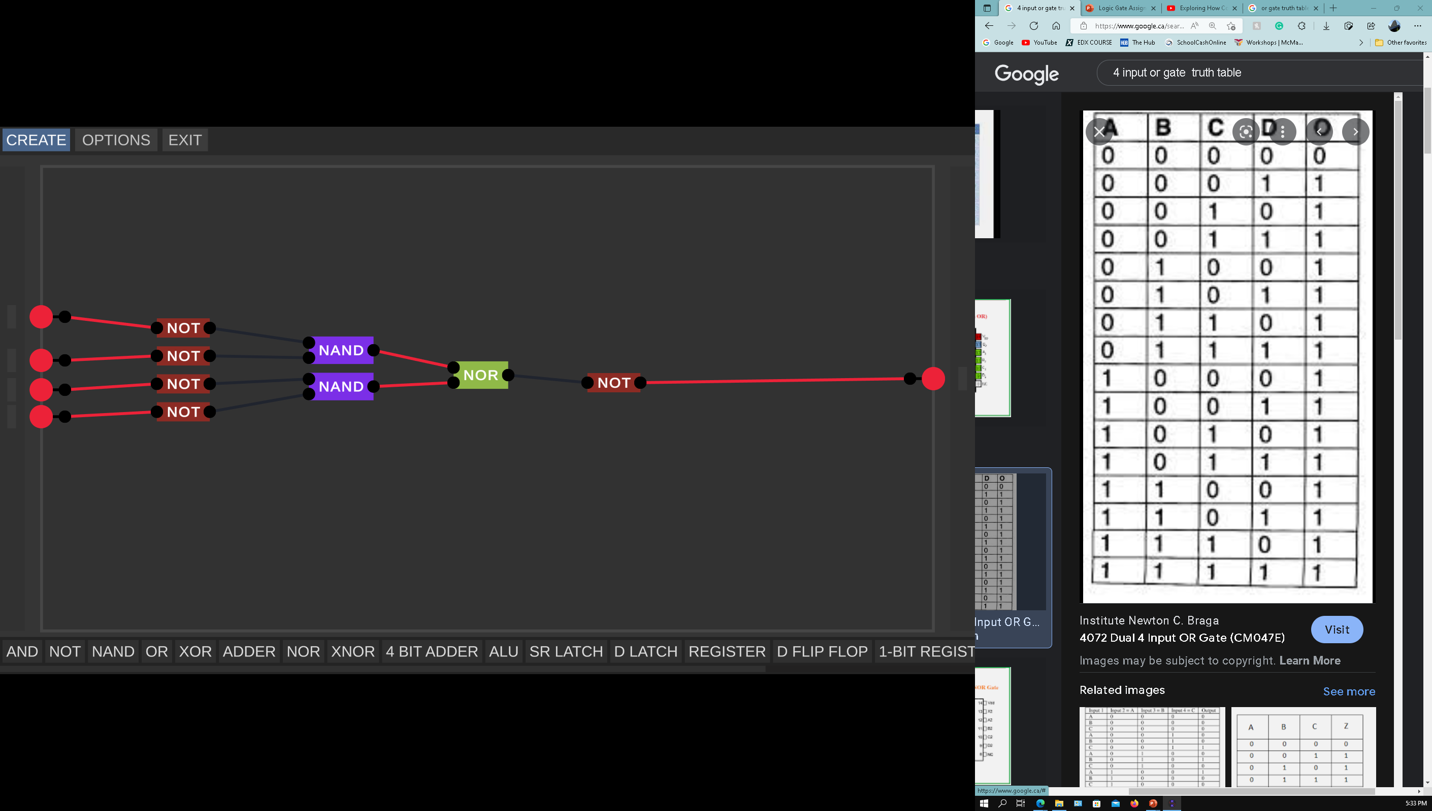
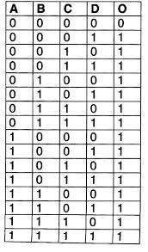
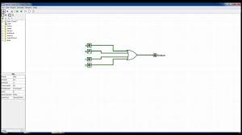
Or Gate with 4 inputs

Slide 17
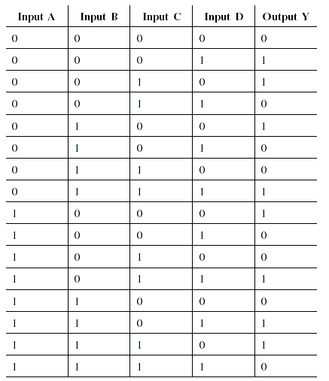
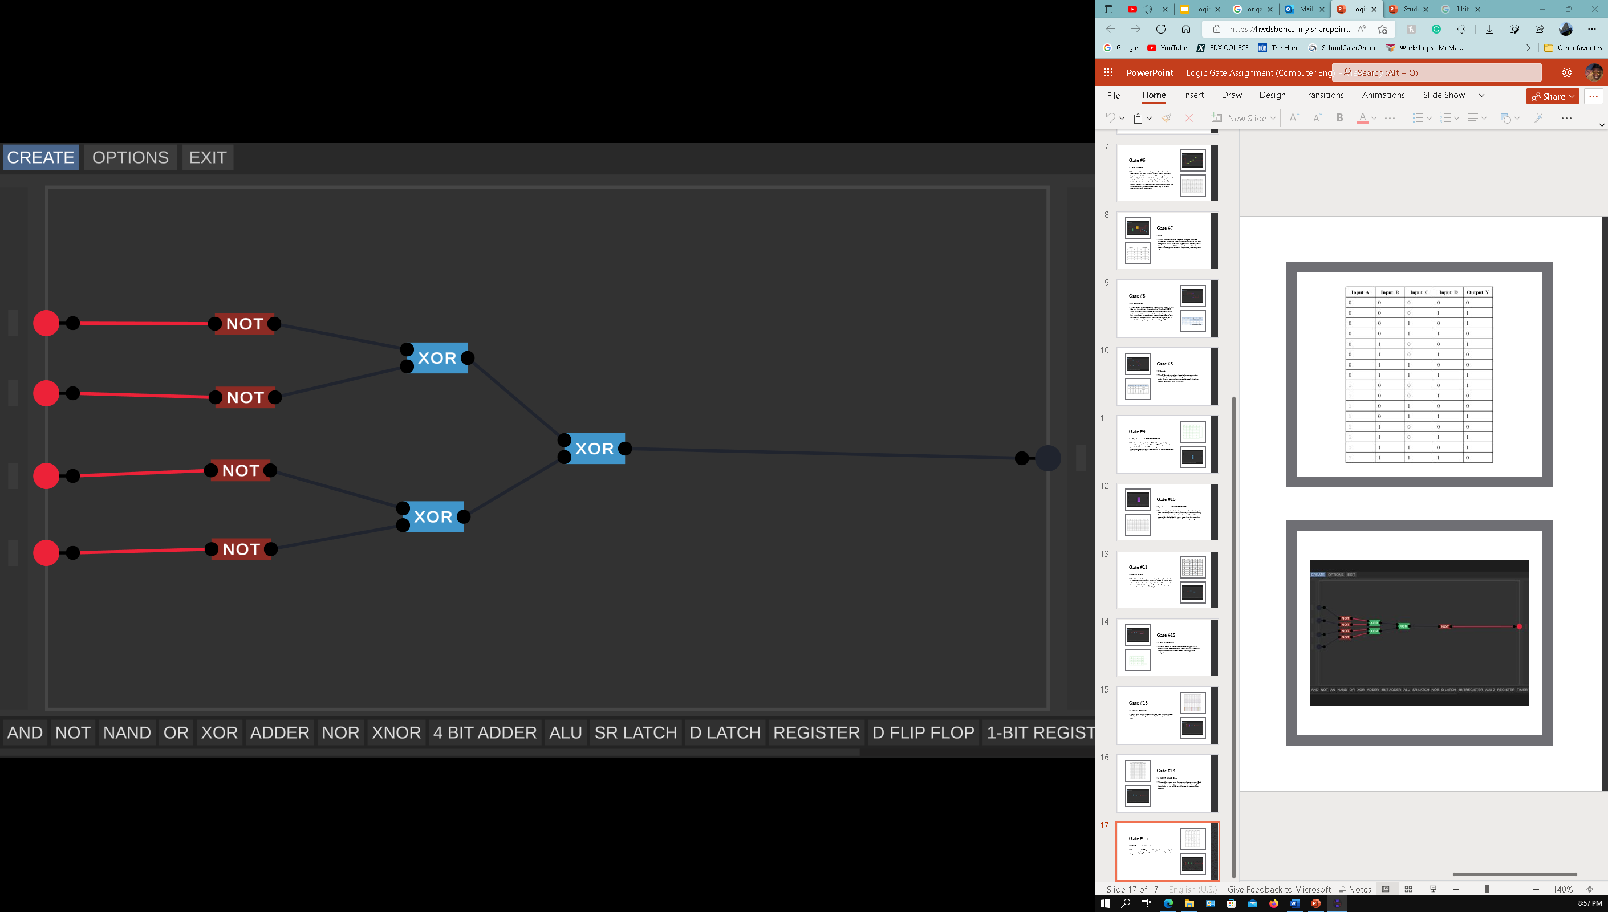
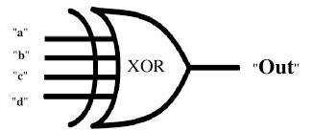
Xor gate with 4 inputs

